Slide 2

AI Home Doctor Chatbot
Hadi Dayeh | Nour Shammaa | Riwa El Kari | Zeinab Mazraani
Home Doctor – December 2024
EECE 490 | American University of Beirut

Slide 3
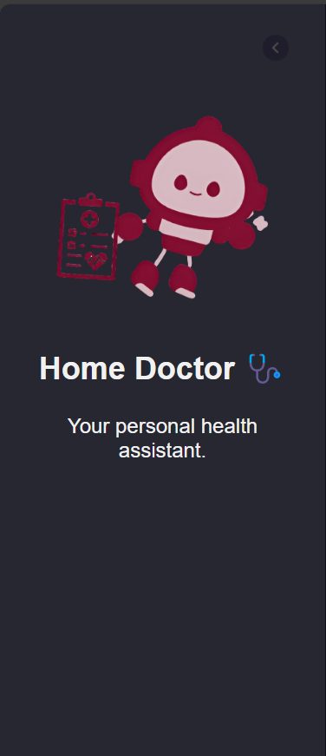
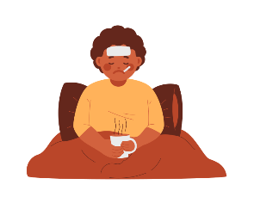
Notes:
Zeinab Picture yourself at home,cold, with a high fever, coughing, and a mug of hot tea is in your hand. your mom is telling you to go to the doctor, but really want to just stay in bed and sleep in your comfortable warm pjamas. And so you tell your mom, as always, that you would rather deal with your pain than going to be checked up.

Slide 4



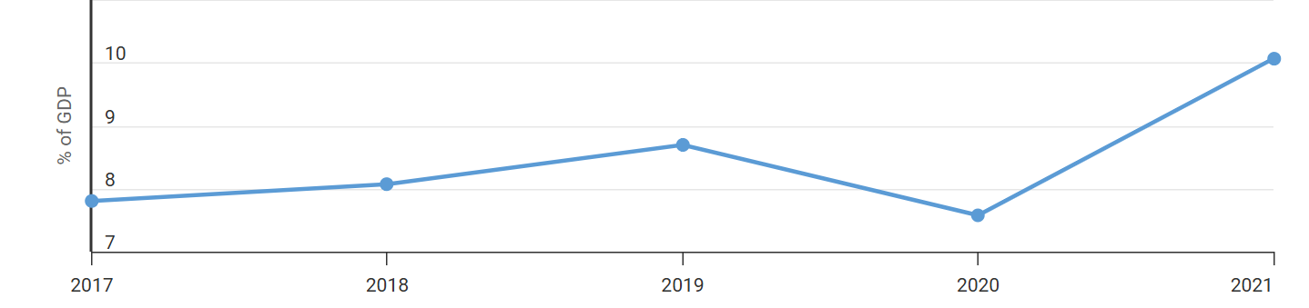


Business Aspect
Why is our Chatbot beneficial?
Convenience and Comfort at home
Huge Demand for Accessible healthcare
24/7 availability
High healthcare costs
Limited access to medical advice
Figure Showing Lebanon healthcare spending % of GDP between 2017 and 2021
Notes:
Nour

Slide 5




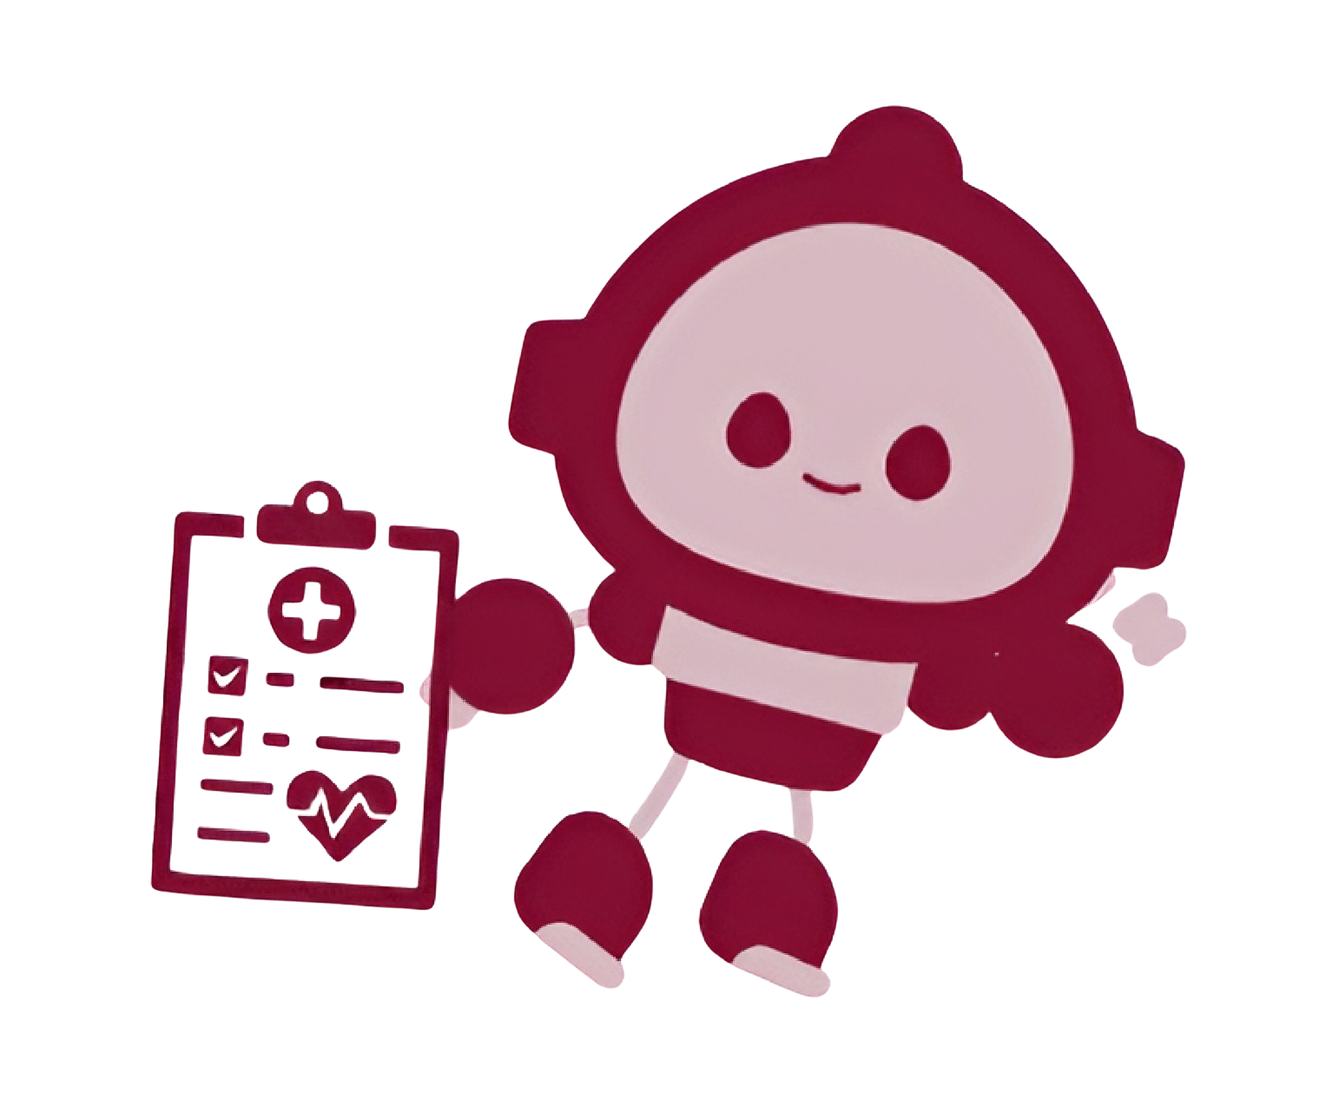
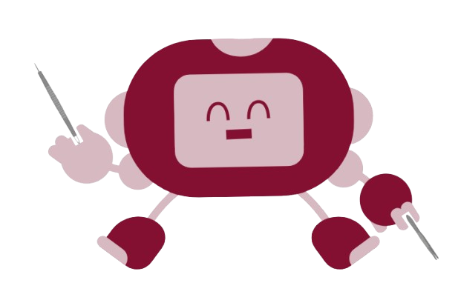



Overview
Meet The Staff:
Hello! How are you feeling today? Which doctor would you like to consult?
Nurse
What are your symptoms? Let me know so I can assist you!
Symptom diagnosis Doctor
Show me, where does it hurt? Do you mind if I take a look at that?
Skin Disease Diagnosis Doctor
Donna at your service! I already scheduled your meds, no need to thank me :)
Medicine Reminder Secretary DONNA
Notes:
Nour

Slide 6
AI Home Doctor Chatbot
Software Tools
Abstract Overview of Software Tools Used
Frontend:
HTML
CSS
JavaScript
Backend:
Flask
Machine Learning Models:
Image Diagnosis Doctor: Image Classifier that is fine tuned based on ResNet18.
Symptom Diagnosis Doctor: Predicts disease based on user symptoms, trained using KNN
Chatbot Framework:
LangChain & OpenAI API
APIs and Integrations
OpenAI GPT
OpenAI Embeddings
FAISS
Whisper OpenAI
Development Tools
Git
VS Code
Docker
Notes:
Riwa

Slide 7
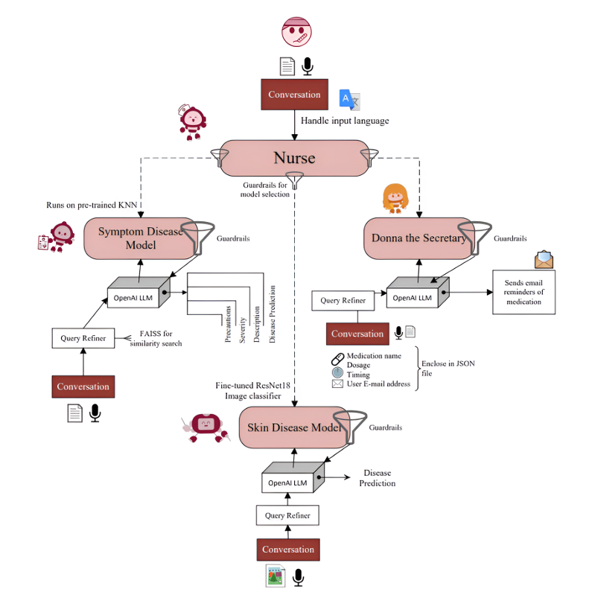
Hierarchical Pipeline: What Makes Our Model Special?
Censored: Guardrails keep it focused on medical tasks only
Bilingual support: Hello! مرحباً …
Handles input text, audio, and image
Query refining for accurate responses
Notes:
riwa

Slide 8
AI Home Doctor Chatbot
Agent
Determine Chain Using Models Detector Based on Conversation
Server
Agent
Conversation
Donna
Conversation
Nurse
Conversation+
images
Conversation
Symptom
Skin
or
or
or
or
Agent
Translation
Server
Notes:
hadi

Slide 9









AI Home Doctor Chatbot
Symptom Disease Chain
42 Disease Dataset
Processes and Analyses Data
KNN Model Prediction
Disease Prediction Model
Description
Severity
Info for Diseases
Vector Embeddings (Open AI)
Indexing
Precautions
Symptom
KNN Model Prediction
Conversation
Query Refiner
GPT
Severity, Description, Precaution
Guardrails
User
Indexing
FAISS
GPT
General Question
Notes:
hadi

Slide 10
AI Home Doctor Chatbot
Nurse
Info on Available Models
Stored in Prompt
Conversation
GPT
Prompt to Model
Delegates to Model from Agent
Describe a Model
Guard
Nurse
Medical Questions
GPT
Notes:
Nour guard rails makes sure that the model can give the ouput based on the input from the use, and so our nurse can describe the model taking into account the guardrail and gives it back to the user, keep in mind it can not answer medical questions as the guardrail restricts it.

Slide 11
AI Home Doctor Chatbot
Skin Disease
10 Skin Diseases
Data Image Processing
Resnet 18 Fine Tuning
Image Classifier
Conversation
GPT
Images of Skin
Classifier Predicts
GPT
Guard-rails
User
Skin-related Questions
GPT
Notes:
Nour we trained a dataset of 10 skin diseases of 6 gigab size, we processsed the data image and then fine tuned resnet 18 to create our image classifier. We have around 80% training accuracy and 75% testing accuracy.

Slide 12
AI Home Doctor Chatbot
DONNA
Guard-rails
User inbox
Conversation
GPT
Extract time, name, dosage, email address
Date parser
Email threading functions
Notes:
zeinab

Slide 13
Business Aspect
Impact on stakeholders
Stakeholders
Patients / Users | Quick access to medical advice, but reliant on accuracy and availability.
Healthcare Providers | Reduced workload for doctors, but still responsible for oversight of the bot's suggestions.
Medication Reminders (family, caretakers, nurses) | Help ensure patients follow their prescribed medication schedules by providing reminders.
Business | Potential growth in user base and revenue, but risks related to accuracy and regulation.

Slide 14
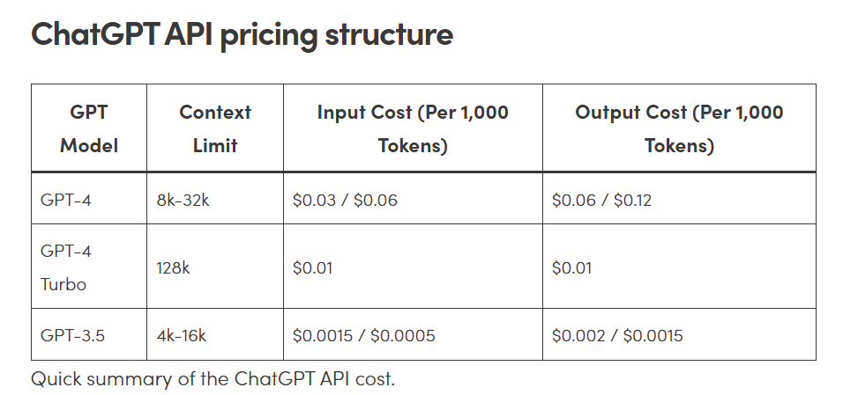
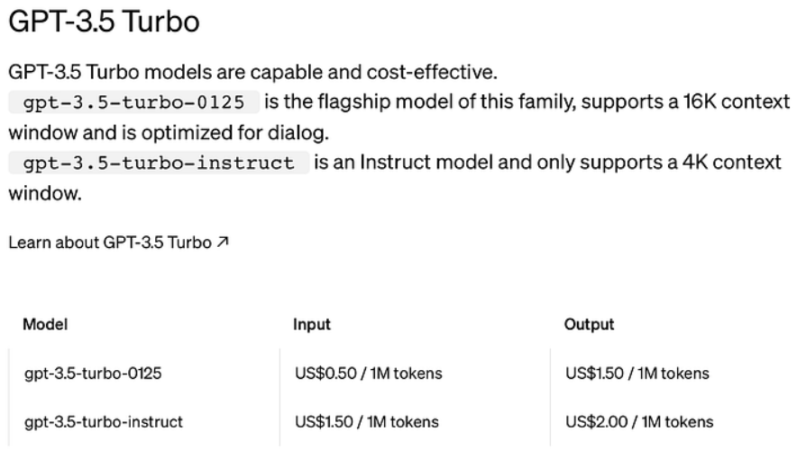
Now let’s talk money:
Assuming an average of five interactions per web visitor (with each being 20 tokens long), a single session would consume about 100 tokens on GPT-4 8K. So, for a business with 1,000 interactions per day, token usage could stretch to 100,000. That amounts to a daily ChatGPT API cost of $9: $3 for input and $6 for output instances.
If each user provides five sentences (15 tokens each), a single piece of feedback would be 75 tokens long. 200 instances per day should therefore take up about 15,000 tokens. That means with the GPT-3.5 Turbo 4K model, your daily ChatGPT API cost would be about $0.15 for input and $0.45 for output.

Slide 15
Business Aspect
Opportunities for Growth
Feature expansion
Active learning
More data
Personalized bot for different family members
Integration with healthcare professionals
Wider language support
Notes:
nour Feature expansion:like providing more bots like a therapist bot
Active learning, where system identifies uncertain predictions and flags them for human review.
More data from AUBMC to add to our model
Integration with healthcare providers to provide online consultations as a new feature

Slide 16
Now let’s diagnose some diseases, shall we?

Slide 17
Thank you!

Slide 18
Business Aspect
Potential Risks and disruptions
Accuracy and Reliability
Misdiagnosis and harm the user.
Ethical Considerations and Legal Issues
If the bot provides misdiagnosis and cause harm, who will face lawsuits?
Regulatory Compliance
Non-compliance with medical regulations (e.g., HIPAA, GDPR) could result in fines.
Technical Failures
Website downtime or malfunction could lead to lack of accessibility.

Slide 19
Business Aspect
Recovery Strategies
Redundant Infrastructure
Deploy on multiple servers or use cloud services with built-in redundancy.
Automated Backups of Models and Data
Regularly back up machine learning models and datasets (CSV files, image datasets) to a secure cloud storage.
Version Control
Use version control (Git or DVC) to track changes and rollback to previous working versions of models or datasets in case of errors or unexpected performance drops.
Dynamic Retraining
Create an automated pipeline to periodically retrain the models using the latest data. In case of adding more diseases would be beneficial
Providing an alternative
Like medical phone consultations in case system crashes

Slide 20



AI Home Doctor Chatbot
SKIN disease Chain
A deep learning model that classifies 23 skin diseases from images, created through training and used for real-time diagnosis.
Environment
Setup
User uploads image
LLM
AI Model
LLM
Chatbot
Data from Datasets
1. Model Overview:
Data: Collected skin disease images with enhanced variety.
Model: Fine-tuned ResNet18 for 23 skin conditions.
2. How to Use the Chain:
Step 1: User interacts with the bot and uploads a skin image.
Step 2: The LLM analyses and predicts possible conditions.
Step 3: The LLM conveys receives the results displayed with top conditions and confidence scores.
3. Internal Process:
Step 1: Uploaded image is passed to a language model (LLM).
Step 2: LLM forwards the image to the trained AI model.
Step 3: The AI model predicts the skin condition.
Step 4: Prediction is returned to the LLM, which presents the result to the user.

Slide 21
AI Home Doctor Chatbot
Symptom Disease Chain
Accurate Diagnoses: Provides reliable disease predictions based on user-reported symptoms with a number of other possible diseases.
Interactive Assistance: Engages users in natural conversations to gather necessary information for diagnosis using LLM GPT model
Scalable & Efficient: Utilizes robust models and similarity search for quick and scalable performance.

Slide 22
AI Home Doctor Chatbot
Symptom Disease Chain
Diagnoses 42 diseases based on user-reported symptoms.
Integrates advanced models and data processing to provide accurate and reliable health assessments.
Setup
User Input Symptom
LLM
Model
Symptom Disease Chain
Data from Dataset
Fetches Description
Processes and Analyses Data
Predicted Disease using KNN
LLM
Bot
Fetches Severity
Fetches Precautions

Slide 23
Main Agent
AI Home Doctor Chatbot
Can describe all the models available
Symptoms
Symptom Disease Chain
Skin Disease Chain
Image
Future Models
Precautions of Predicted Disease
Severity of the Symptoms of Predicted Disease
Description of Predicted Disease
Predicted skin disease
Notes:
Not here

Slide 24
Business Aspect
Revenue Model and Differentiation
Revenue
Subscription | Monthly/yearly subscriptions for premium features like Donna.
Basic Access | Allow user a limited number of free use.
Partnership with Healthcare Providers | Partnership with AUBMC.

Slide 25
Business Aspect
Target Audience
Elderly People People with limited access to healthcare facilities Healthcare Professionals Individuals seeking Cost-Effective solutions
Value Proposition
24/7 Accessible Health Guidance Cost effective User-friendly and convenient Improves health literacy
Notes:
zeinab

Slide 26
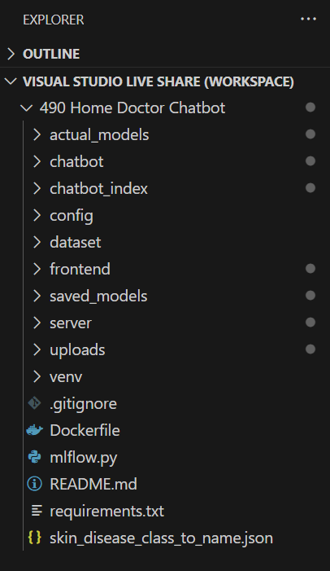
AI Home Doctor Chatbot
Code Architecture
AI Home Doctor Chatbot has the following features:
The Chatbot provides Seamless interaction with the user
Has a full functioning memory
Has bilingual capabilities (Arabic and English)
Receives audio Recordings
Modular and can easily add new models
It does not provide information on things it shouldn’t
It is powered by GPT API (4o-mini model)
It uses OpenAI Embeddings for swift storing and searching for large amounts of data
It uses query refiners (Powered on GPT 3.5-turbo), for logic, and to minimize user-to-bot misunderstandings
Notes:
Not here

Slide 27
AI Home Doctor Chatbot
Today’s
main topics:
01.
04.
Code Architecture
Symptom Disease Chain
02.
05.
Software Tools
Skin disease Chain
03.
Chatbot Logic

